Slide 1
CST-411
Analysis and visualization

Slide 2

License and References
This work is licensed under a Creative Commons Attribution-NonCommercial-ShareAlike 4.0 International License
Fore more details: https://creativecommons.org/licenses/by-nc-sa/4.0/
The author is indebted to the generosity of others who have provided example problems and datasets. Where appropriate, external sources are cited both in the slides and in Jupyter Notebooks
Images from around the Web are also used to help convey concepts
Content that is reused in these slides is either open licensed or, as I understand it, meets the Fair Use Doctrine for educational reuse.

Slide 3
License and References
My university offering of this course has an introductory Python course as a prerequisite
That course uses
Python Programming: An Introduction to Computer Science 2010, 3rd Edition, John Zelle, Franklin, Beedle & Associates Inc., ISBN 9781590282755
At times, example problems from that text will be cited

Slide 4
Mystery dataset
There is data available at: http://narock.github.io/teaching/CST-411/sample.tsv
It is a Tab Separated Variable file
Try reading it into a notebook and exploring the data
These data are related to something that’s in the news this week (September 12, 2018)

Slide 5
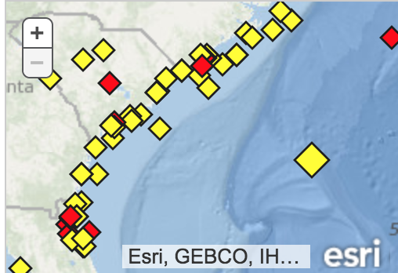
Hurricane florence
These data come from the National Oceanographic and Atmospheric Administration buoy program
These particular data are from buoy 41002 positioned 225 nautical miles south of Cape Hatteras, North Carolina
https://www.ndbc.noaa.gov/station_page.php?station=41002
These are the same buoys used
in the weather forecasting this week
Image Credit: NOAA
Our bouy

Slide 6
Hurricane florence
The data are all publicly available at:
https://www.ndbc.noaa.gov/station_page.php?station=41002
I manually copied the data from the website and formatted it into a TSV file stored at: http://narock.github.io/teaching/CST-411/sample.tsv
There are also freely available Python libraries for working with this buoy data (and related data) provided by Unidata. The library is called Siphon and is available at: https://github.com/Unidata/siphon
Image Credit: NOAA

Slide 7
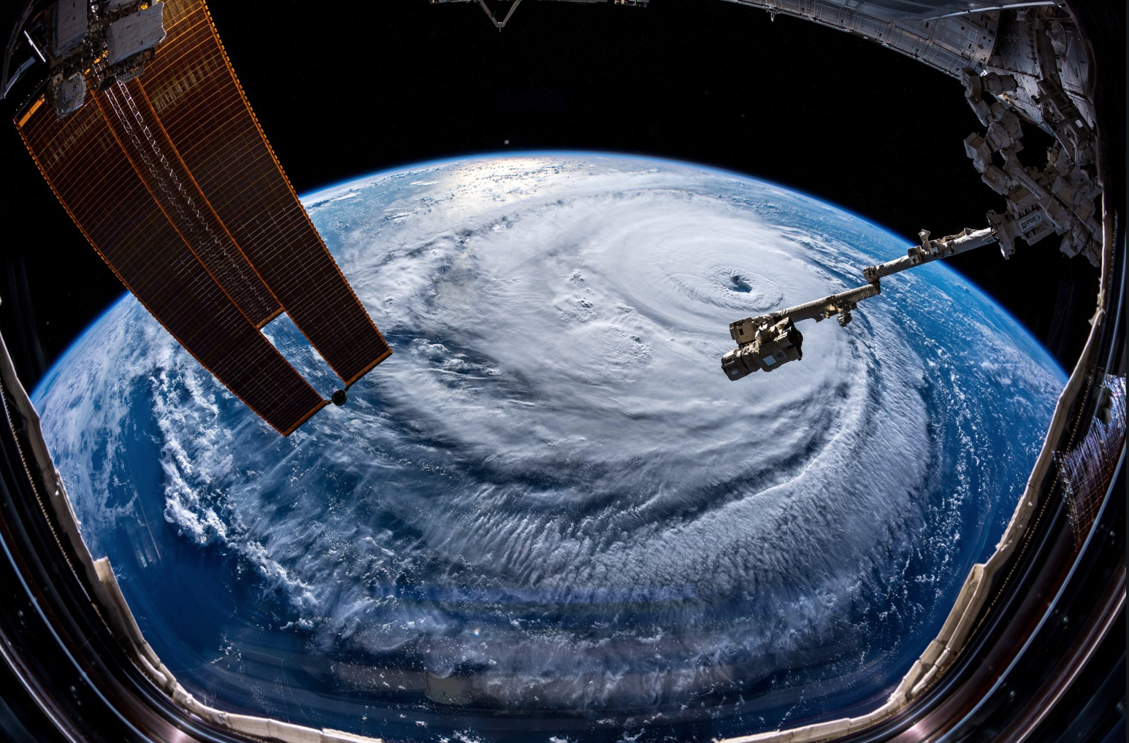
Hurricane Florence as seen from the International Space Station, Credit: NASA

Slide 8
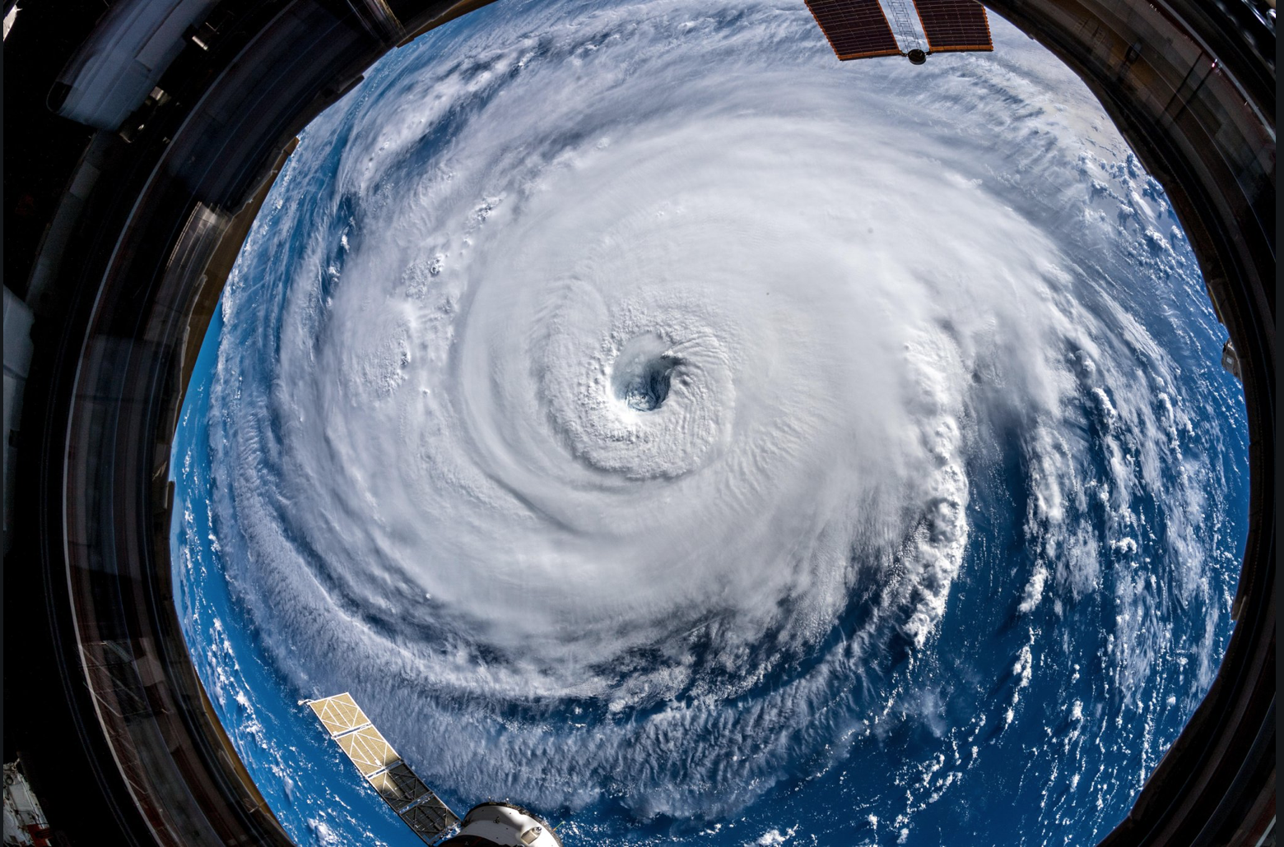
Hurricane Florence as seen from the International Space Station, Credit: NASA

Slide 9
Tell a story with data
There are 4 dataset descriptions available. Use what you’ve learned about scientific computing to tell a story with the data.
Specifically,
Read the data into a Jupyter Notebook
Explore the data. How many rows/columns? Anything look out of place?
Analyze and visualize the data – what is it telling you?
Use your notebook to explain your data, analysis, and conclusions to your classmates

Slide 10
Dataset 1 – National Temperatures
This dataset provides yearly average temperatures for the United States from 1895-2017.
The temperatures are in degrees Fahrenheit and the dataset has three columns: Date, Temperature, and Anomaly. Missing values are represented by -99.
The century 1900 to 2000 is used as a baseline. The average temperature during this century was computed and found to be 52.02 degrees Fahrenheit. The Anomaly column is the difference between this baseline temperature and each yearly average. This column can be used to find excessively hot (or cold) years.
Data is available at: http://narock.github.io/teaching/CST-411/visualization/national_avg_temp.csv
Original Source: https://www.ncdc.noaa.gov/cag/national/time-series

Slide 11
Dataset 2 Maryland Temperatures
This dataset provides yearly averaged Maryland temperatures from 1895-2017.
The temperatures are in degrees Fahrenheit and the dataset has three columns: Date, Temperature, and Anomaly. Missing values are represented by -99.
The century 1900 to 2000 is used as a baseline. The average temperature during this century was computed and found to be 53.8 degrees Fahrenheit. The Anomaly column is the difference between this baseline temperature and each yearly average. This column can be used to find excessively hot (or cold) years.
Data is available at: http://narock.github.io/teaching/CST-411/visualization/md_avg_temp.csv
Original Source: https://www.ncdc.noaa.gov/cag/statewide/time-series

Slide 12
Dataset 3 - U.S. Wildfires
This dataset contains data on wildfires in the U.S. The data covers the time period 2000 through 2018.
The data is available at: http://narock.github.io/teaching/CST-411/visualization/us_wildfires.csv
Original source: Source: https://www.ncdc.noaa.gov/societal-impacts/wildfires/
The data has four columns: year, number of fires, acres burned, acres burned per fire

Slide 13
Dataset 4 – Moisture Stress Index
The Moisture Stress Index helps measure the effects of drought and catastrophic wetness in the U.S. by measuring national crop yield. Corn and soybean crops are major components of the U.S. farming and the Moisture Stress Index uses these two crops to approximate the effects of extreme rain and drought. A lack or an abundance of soil moisture during critical phases of the crop growth and development cycle - known as moisture stress - affects U.S. corn and soybean yield. Soil moisture conditions in July and August were found to be the best indicators of average crop yield for corn and soybeans, and as such, are used in creating the Moisture Stress Index. The Moisture Stress Index ranges from 0 to 100. The value can be interpreted as the percent of crops in the growing region impacted by excessive rain or drought. For example, an index value of 20 implies that 20% of the crop growing region was impact by drought or excessive rain that year. The Moisture Stress index doesn't distinguish between stress from drought or stress from extreme rain. It only tell us that stress occurred. Thus, an index value of 20 tells us that 20% of the crop growing region was impacted by droughts or rain, but not which.
The data has two columns: year and moisture stress index
The data is available at: http://narock.github.io/teaching/CST-411/visualization/corn_moisture_stress_index.txt
Original source: https://www.ncdc.noaa.gov/societal-impacts/cmsi/

Slide 14
Questions you might ask
Are there temperature trends locally (Maryland)?
Are there temperature trends nationally?
How do historical Maryland temperatures (and trends) compare to the national averages?
Is the U.S. seeing more or less wildfires this decade as compared to previous decades?
Do we see increases in wild fires at the same time we see increases in national temperatures?
What conclusions can we make regarding drought and excessive rain’s impacts from the Moisture Stress Index?
Can we overlay any of these datasets and visualize them together?

